Slide 1
Informed Search Algorithms

Slide 2
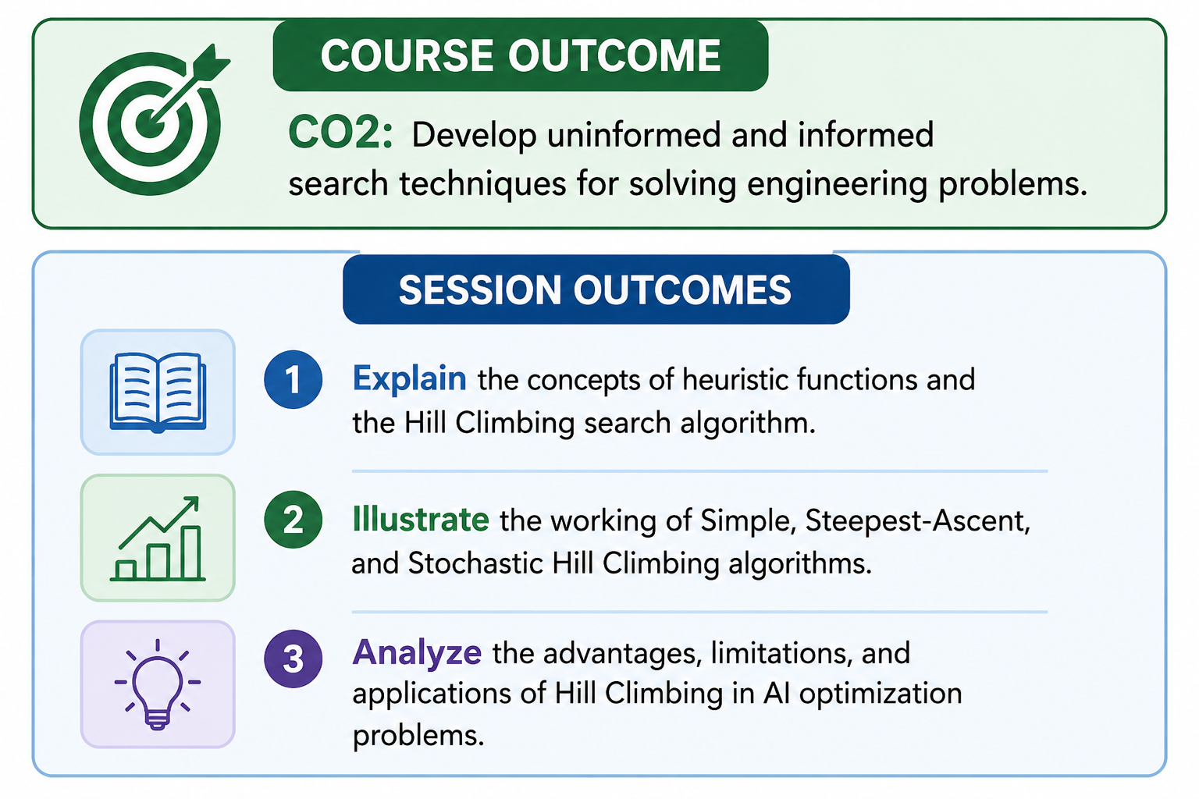

Slide 3
Heuristics function
Heuristic is a function which is used in Informed Search, and it finds the most promising path.
It takes the current state of the agent as its input and produces the estimation of how close agent is from the goal.
The heuristic method, however, might not always give the best solution, but it guaranteed to find a good solution in reasonable time.
Heuristic function is represented by h(n), and it calculates the cost of an optimal path between the pair of states.

Slide 4

Hill Climbing algorithm
Hill Climbing is a form of heuristic search algorithm, used in solving optimization related problems in Artificial Intelligence domain.
The algorithm starts with a non-optimal state and iteratively improves its state until some predefined condition is met. The condition to be met is based on the heuristic function.
The aim of the algorithm is to reach an optimal state which is better than its current state.
The starting point which is the non-optimal state is referred to as the base of the hill and it tries to constantly iterate (climb) until it reaches the peak value --Hill Climbing

Slide 5
Hill Climbing algorithm
Given a large set of inputs and a good heuristic function, it tries to find a sufficiently good solution to the problem.
This solution may not be the global optimal maximum.
Hill climbing as a variant of generate and test algorithm as it takes the feedback from test procedure. Then this feedback is utilized by the generator in deciding the next move in search space.

Slide 6
Key Features of Hill Climbing
Greedy Approach: The algorithm moves in the direction of optimizing the cost i.e. finding Local Maxima/Minima
No Backtracking: It cannot remember the previous state of the system -so backtracking to the previous state is not possible
Feedback Mechanism: The feedback from the previous computation helps in deciding the next course of action i.e. whether to move up or down the slope

Slide 7
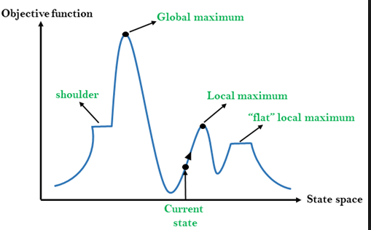
State space diagram
State space diagram is a graphical representation of the set of states our search algorithm can reach vs the value of our objective function (the function which we wish to maximize).
X-axis : denotes the state space ie states or configuration our algorithm may reach.
Y-axis : denotes the values of objective function corresponding to a particular state.
The best solution will be that state space where objective function has maximum value (global maximum).

Slide 8
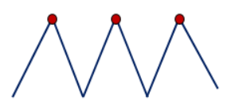
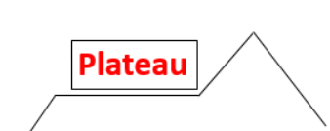
Different regions in the State Space Diagram
1. Local maximum : It is a state which is better than its neighboring state however there exists a state which is better than it(global maximum). This state is better because here value of objective function is higher than its neighbors.
2. Global maximum : It is the best possible state in the state space diagram. This because at this state, objective function has highest value.
3. Plateau/flat local maximum : It is a flat region of state space where neighboring states have the same value.
4. Ridge : It is region which is higher than its neighbours but itself has a slope. It is a special kind of local maximum.
5. Current state : The region of state space diagram where we are currently present during the search.
6. Shoulder : It is a plateau that has an uphill edge.

Slide 9
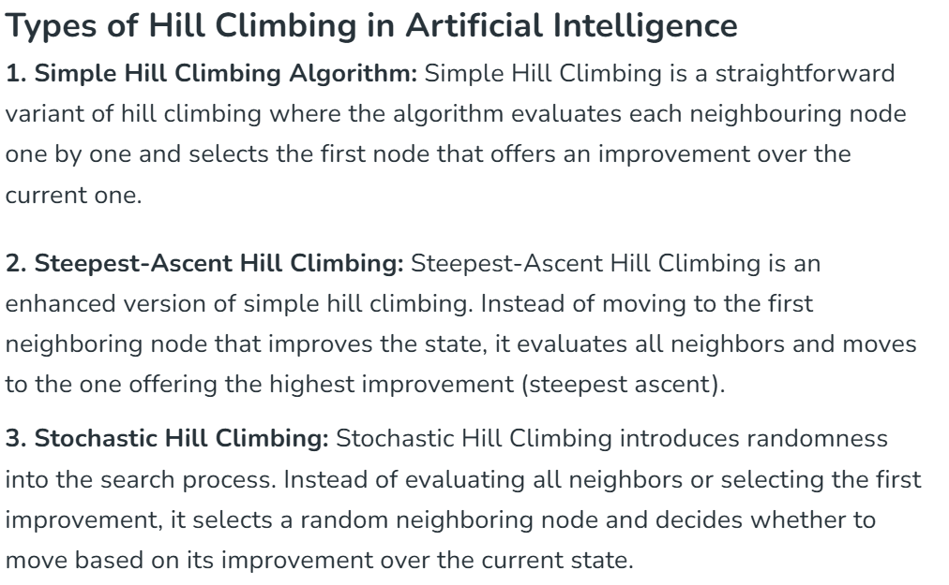

Slide 10
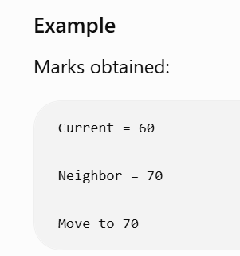
1. Simple Hill climbing
Simplest form of the Hill Climbing Algorithm.
It only takes into account the neighboring node for its operation.
If the neighboring node is better than the current node then it sets the neighbor node as the current node.
The algorithm checks only one neighbor at a time.
Key feature of the Simple Hill Climbing Algorithm
  Since it needs low computation power, it consumes lesser time
  The algorithm results in sub-optimal solutions and at times the solution is not guaranteed

Slide 11
Algorithm for Simple Hill climbing
Step 1 : Evaluate the initial state. If it is a goal state then stop and return success.
Otherwise, make initial state as current state.
Step 2 : Loop until the solution state is found or there are no new operators present which can be applied to current state.
  a) Select a state that has not been yet applied to the current state and apply it to produce a new state.
  b) Perform these to evaluate new state
  i. If the current state is a goal state, then stop and return success.
  ii.If it is better than the current state, then make it current state and proceed further.
  iii. If it is not better than the current state, then continue in the loop until a solution is found.
Step 3 : Exit.

Slide 12
Steepest-Ascent Hill climbing
It first examines all the neighboring nodes and then selects the node closest to the solution state as next node.
An advanced form of simple Hill Climbing Algorithm. It runs through all the nearest neighbor nodes and selects the node which is nearest to the goal state.
The algorithm requires more computation power than Simple Hill Climbing Algorithm as it searches through multiple neighbors at once.
Algorithm:
  Step 1 : Evaluate the initial state. If it is goal state then exit else make the current state as initial state
  Step 2 : Repeat these steps until a solution is found or current state does not change
    i. Let ‘target’ be a state such that any successor of the current state will be better than it;
    ii. for each operator that applies to the current state
  a. apply the new operator and create a new state
  b. evaluate the new state
  c. if this state is goal state then quit else compare with ‘target’
  d. if this state is better than ‘target’, set this state as ‘target’
  e. if target is better than current state set current state to Target
  Step 3 : Exit

Slide 13
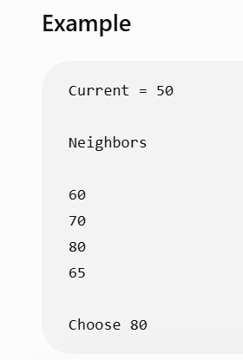

Slide 14
3. Stochastic hill climbing
Stochastic Hill Climbing doesn’t look at all its neighboring nodes to check if it is better than the current node instead, it randomly selects one neighboring node, and based on the pre-defined criteria it decides whether to go to the neighboring node or select an alternate node.

Slide 15
Algorithm
1. Examine the current state, Return success if it is a goal state
2. Continue the Loop until a new solution is found or no operators are left to apply
Let ‘Temp’ be a state such that any successor of the current state will have a higher value for the objective function. For all operators that can be applied to the current state
Apply the operator to create a new state
Examine new state
If Current State = Goal State, Return success and exit
Else if New state is better than Temp then set this state as Temp
If Temp is better than Current State set Current state to Target

Slide 16
Advantage of Hill Climbing Algorithm in AI
Hill Climbing is very useful in routing-related problems like Travelling Salesmen Problem, Job Scheduling, Chip Designing, and Portfolio Management
It is good in solving the optimization problem while using only limited computation power
It is more efficient than other search algorithms
Hill Climbing Algorithm is a very widely used algorithm for Optimization related problems as it gives decent solutions to computationally challenging problems.
It has certain drawbacks associated with it like its Local Minima, Ridge, and Plateau problem which can be solved by using some advanced algorithm.

Slide 17
Problems in different regions in Hill climbing
Hill climbing cannot reach the optimal/best state(global maximum) if it enters any of the following regions :
1. Local maximum : At a local maximum all neighboring states have a values which is worse than than the current state. Since hill climbing uses greedy approach, it will not move to the worse state and terminate itself. The process will end even though a better solution may exist.
  To overcome local maximum problem : Utilize backtracking technique. Maintain a list of visited states. If the search reaches an undesirable state, it can backtrack to the previous configuration and explore a new path.
2. Plateau : On plateau all neighbors have same value . Hence, it is not possible to select the best direction.
  To overcome plateaus : Make a big jump. Randomly select a state far away from current state. Chances are that we will land at a non-plateau region
3. Ridge : Any point on a ridge can look like peak because movement in all possible directions is downward. Hence the algorithm stops when it reaches this state.
  To overcome Ridge : In this kind of obstacle, use two or more rules before testing. It implies moving in several directions at once.

Slide 18
Local Search algorithms
Search algorithms like breadth-first and depth-first explore all the search space systematically by keeping one or more paths in memory and by recording which alternatives have been explored.
When a goal is found, the path to that goal constitutes a solution.
Local search algorithms can be very helpful if we are interested in the solution state but not in the path to that goal. They operate only on the current state and move into neighboring states .

Slide 19
Local Search algorithms
Local search algorithms have 2 key advantages:
  They use very little memory
  They can find reasonable solutions in large or infinite (continuous) state spaces.
Some examples of local search algorithms are:
  Hill-climbing
  Simulated annealing

Slide 20
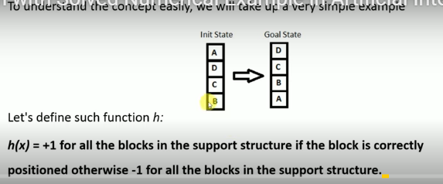
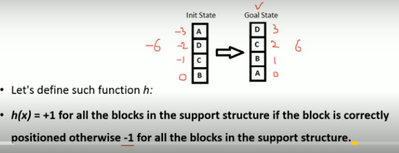
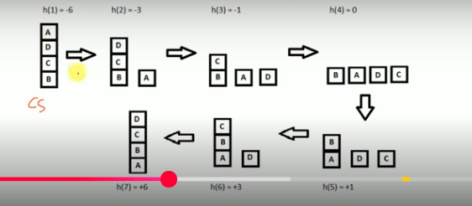
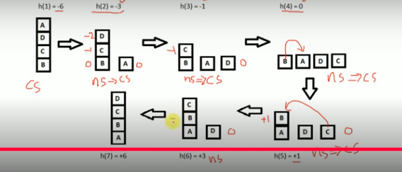
Example

